Slide 1
Digital Portfolio
STUDENT NAME: RAKSHANT.K
REGISTER NO:autunm1703212405426
NMID:D5675426644FE2290D944D96B37C73
DEPARTMENT: BCA
COLLEGE:AKSHEYAA COLLEGE ARTS AND SCIENCE/ UNIVERSITY OF MADRAS

Slide 2
PROJECT TITLE
✅ Simple & Formal Titles (best for resume/project report)
Digital Portfolio Development
Design and Implementation of a Digital Portfolio
Web-based Digital Portfolio System
Personal Digital Portfolio Website
Interactive Digital Portfolio

Slide 3

AGENDA
Problem Statement
Project Overview
End Users
Tools and Technologies
Portfolio design and Layout
Features and Functionality
Results and Screenshots
Conclusion
Github Link

Slide 4

PROBLEM STATEMENT
Traditional resumes and paper-based portfolios have limitations in showcasing creativity, interactivity, and dynamic updates. Employers and academic evaluators prefer accessible, visually appealing, and interactive formats. A digital portfolio solves this issue by providing an online platform to present skills, projects, and achievements effectively.

Slide 5

PROJECT OVERVIEW
The project focuses on developing a Digital Portfolio Website to showcase personal details, academic background, technical skills, and project work. The portfolio emphasizes user-friendly design, responsive layout, and interactive elements, enabling viewers to navigate easily and understand the profile.

Slide 6

WHO ARE THE END USERS?
Students & Professionals – To showcase their skills and achievements.
Recruiters & Employers – To evaluate candidates’ capabilities beyond a traditional resume.
Academic Institutions – For student project submissions and evaluations.

Slide 7
TOOLS AND TECHNIQUES
Frontend: HTML, CSS, JavaScript, Bootstrap/Tailwind
Backend (optional): PHP / Node.js
Version Control: Git & GitHub
Design Tools: Canva / Figma (for layout design)

Slide 8
POTFOLIO DESIGN AND LAYOUT
Home Page – Introduction & banner section
About Section – Personal details & academic background
Skills Section – Technical and soft skills
Projects Section – Project details with links
Contact Section – Email, phone, and social links
Responsive Layout – Works on desktop, tablet, and mobile
‹#›

Slide 9
FEATURES AND FUNCTIONALITY
Interactive navigation with responsive design
Project showcase with images, descriptions, and links
Contact form for direct communication
Social media and GitHub integration
Easy scalability for future updates

Slide 10
RESULTS AND SCREENSHOTS
Successfully deployed Digital Portfolio Website
Enhanced visibility of projects and skills
Positive feedback from peers and mentors
(Insert portfolio screenshots here: Home Page, Projects Page, Contact Pa
‹#›

Slide 11
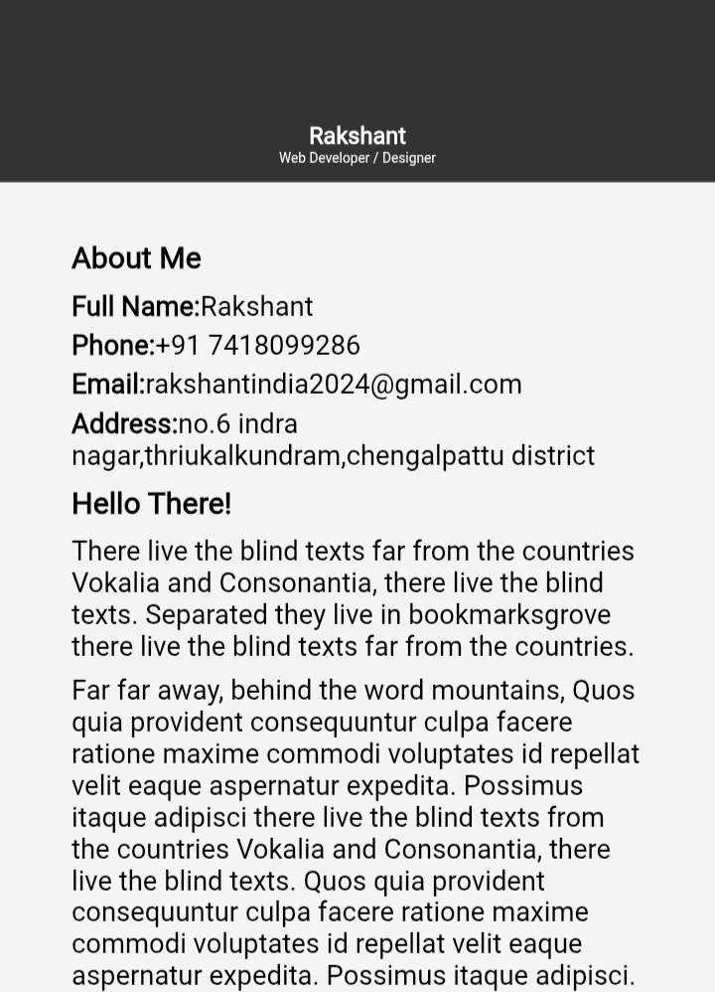
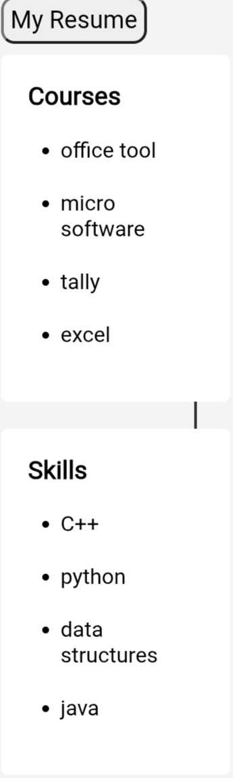
RESULTS AND SCREENSHOTS

Slide 12
CONCLUSION
The Digital Portfolio provides a modern and interactive way to showcase skills and achievements. It bridges the gap between candidates and recruiters by offering a dynamic, accessible, and creative presentation of personal and professional information.
GITHUP LINK:
https://github.com/rakshantindia2024-creator/digital_portfolio.git
‹#›

